Slide 1
Name:- Harsh Parmar
Reg. No. :- 20MCA10069

Slide 2
Introduction to Unity
A BEGINNER’S TUTORIAL FOR UNITY

Slide 3
Overview
Unity
  Creating a Project
  Interface
  Navigation
  Customizing Windows
  Asset Store
  Adding Objects to Scene
  Scene Management
  Prefabs

Slide 4
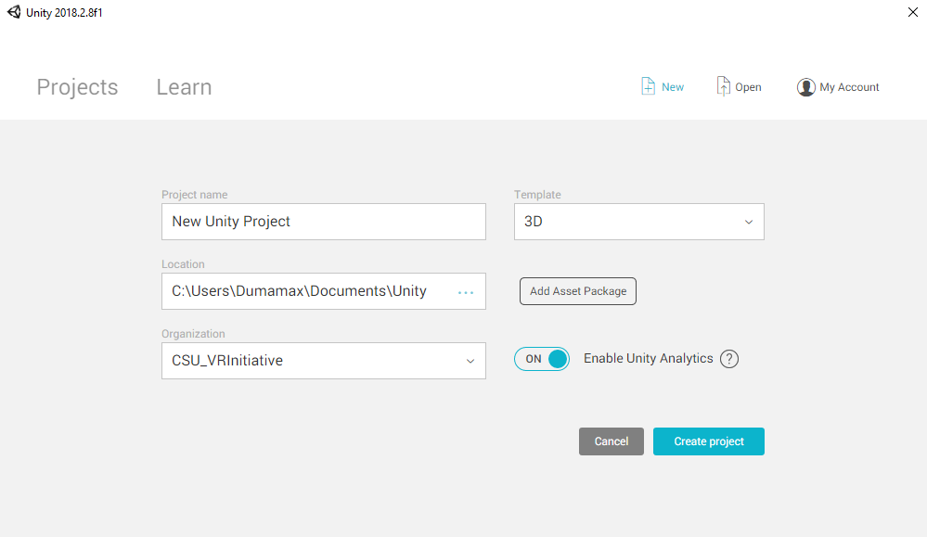
Creating a Project

Slide 5
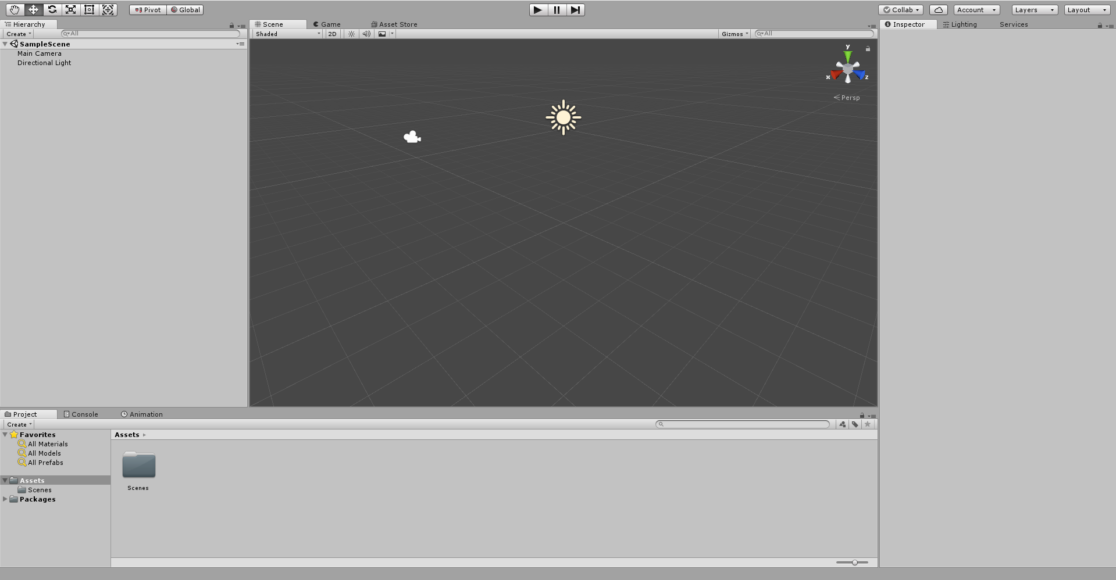
Interface

Slide 6
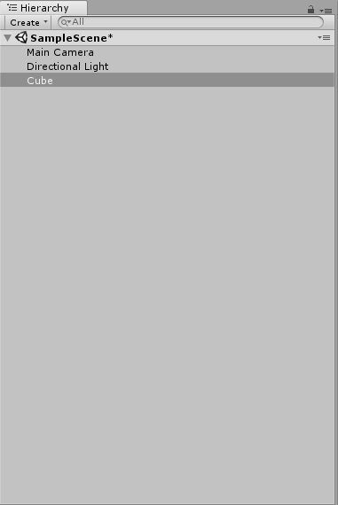
Hierarchy

Slide 7
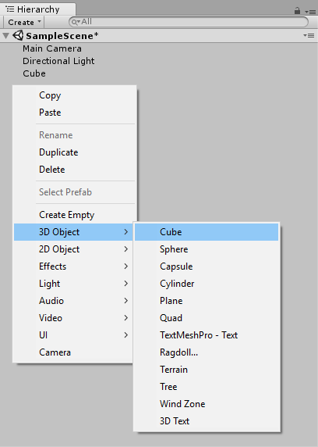
Create a Cube

Slide 8
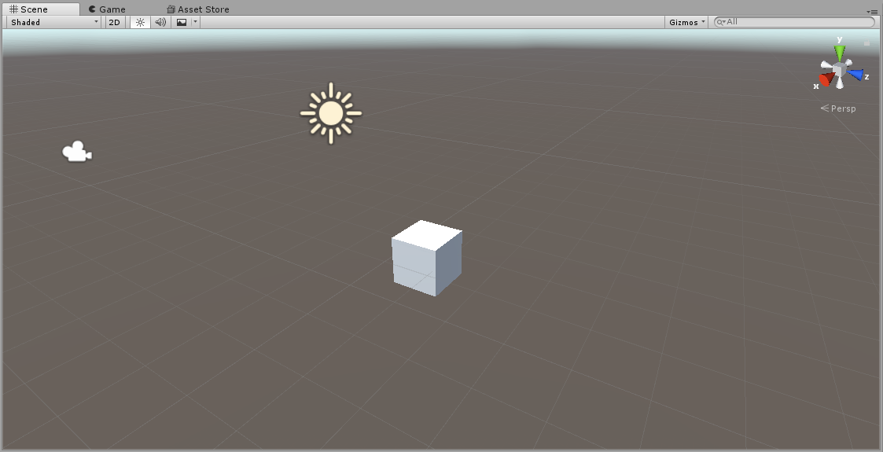
Scene/Game View

Slide 9
Navigating Scene View
Hand Tool: Click and drag to move scene and navigate world
Move Tool: Move objects within the world (X, Y, Z)
Rotate Tool: Rotate objects along the X, Y, or Z axis
Scale Tool: Scale object’s size either along an axis, or overall
Rect Tool: Mainly used for 2D games and UI elements
Universal Tool: Has functionality to move, rotate, and scale

Slide 10
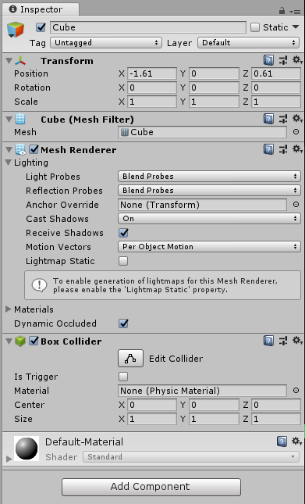
Inspector

Slide 11
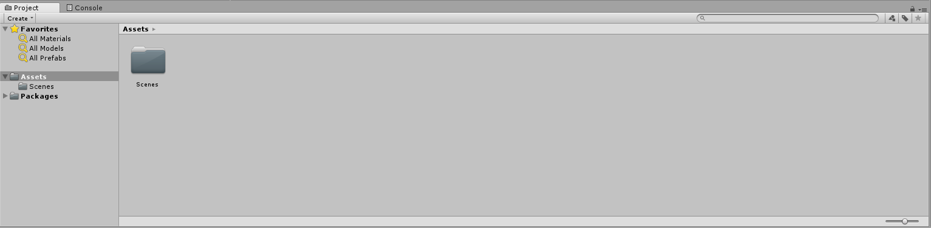
Project Window

Slide 12
Moving Windows to make Custom Layouts
Demo in Unity
  Scale window size
  Change window locations
Notes:
Show how to:
Scale Window size
Drag and drop windows

Slide 13
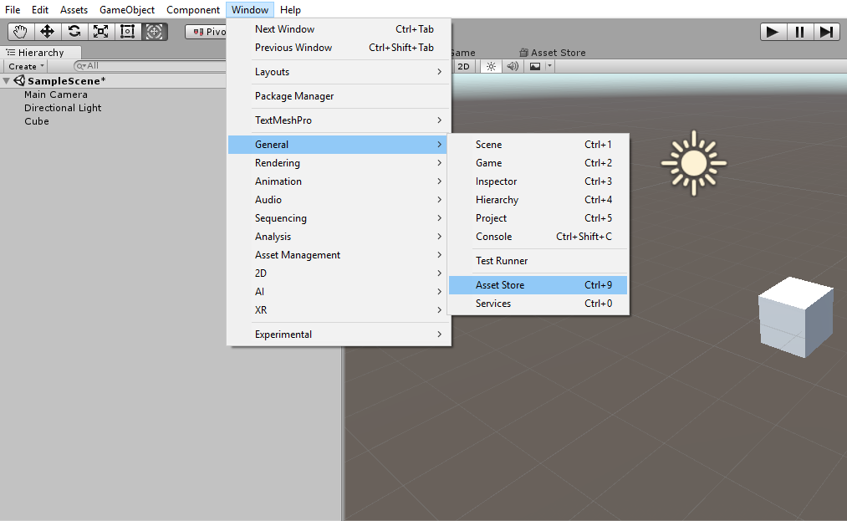
Adding Asset Store as a Window

Slide 14
Importing Assets from Store
Demo in Unity
  Navigate to Props
  Sort by FREE assets
  Find asset pack (Low Poly Survival Essentials)
  Download/Import pack
Notes:
Show how to:
Navigate to Props
Sort by FREE assets
Find asset pack
Download/Import pack

Slide 15
Adding Objects to Scene
In the Project Window, navigate to :
  Assets/BrokenVector/LowPolySurvivalEssentials/Prefabs
Drag and drop Terrain_Plane and set location to (0,0,0)
Add objects for fun ☺
Move camera to see scene in Game View

Slide 16
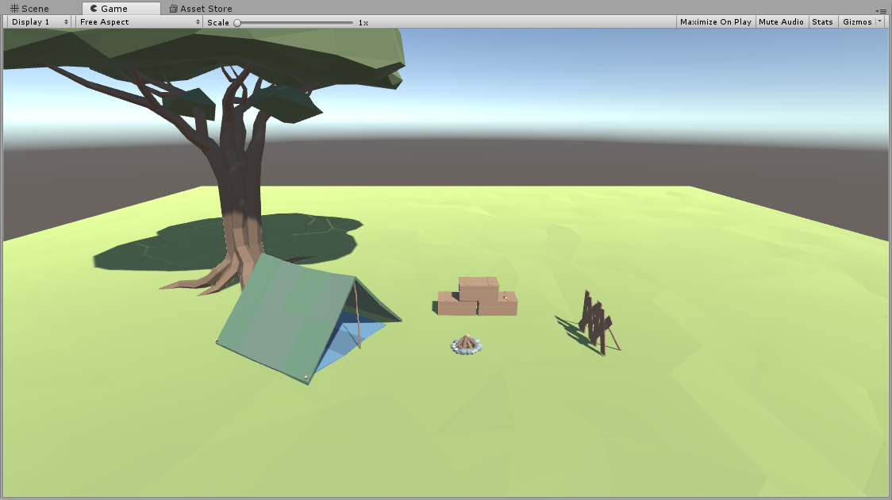

Slide 17
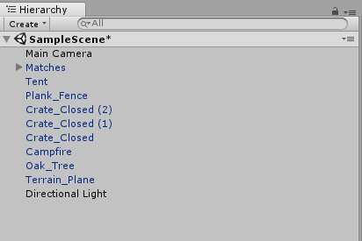
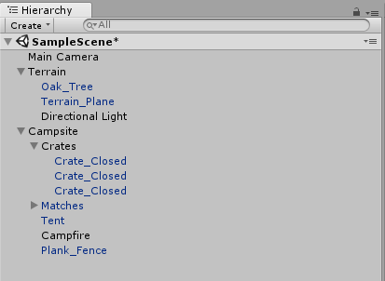
Scene Management
Use Empty Game Objects to create a “Folder Structure”
Before After

Slide 18
Thank You

